Slide 1
Control Transfer or Branching Instructions
P.RAJESH
Asst Professor
CRIT

Slide 2
Control Transfer or Branching Instructions
Transfers the flow of execution of the program to a new address specified in the instruction directly or indirectly.
When executed will get new contents in CS and IP registers.
Two forms
1. Unconditional Control Transfer instructions
2. Conditional Control Transfer Instructions

Slide 3
Unconditional Control Transfer Instructions
Execution control is transferred to the specified location independent of any status or condition.
CS and IP are unconditionally modified to the new CS and IP.

Slide 4
Conditional Control Transfer Instructions
The control is transferred to the specified location if the condition is satisfied else the execution flow continues as usual.
The results of previous operations are replicated by the conditional code flags.

Slide 5
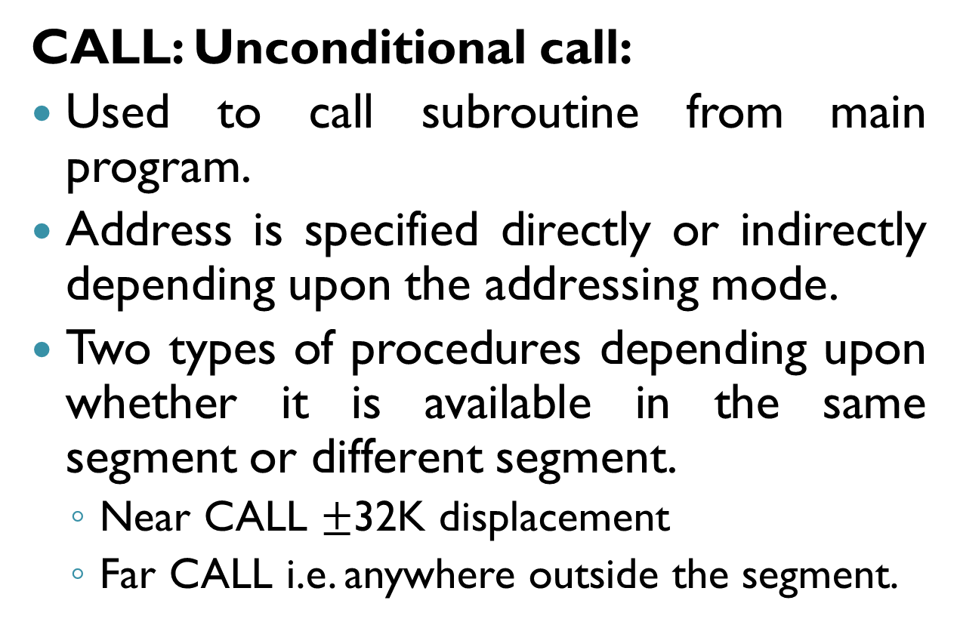
Unconditional Branch Instructions
CALL: Unconditional call:
Used to call subroutine from main program.
Address is specified directly or indirectly depending upon the addressing mode.
Two types of procedures depending upon whether it is available in the same segment or different segment.
Near CALL $±$32K displacement
Far CALL i.e. anywhere outside the segment.

Slide 6
CALL instruction
On execution, this instruction stores the IP( address of the next instruction) and CS onto the stack and loads the CS and IP registers with the segment and offset addresses of the procedure to be called.
Near CALL it pushes only IP and in case of FAR CALL it pushes CS and IP both onto the stack.

Slide 7
RET: Return from procedure
At each CALL instruction, IP and CS of the next instruction is pushed onto stack, before the control is transferred to the procedure.
At the end of procedure, after RET execution the next instruction address is loaded from stack(Previously stored) to CS and IP registers.

Slide 8
INT N: Interrupt Type N
256 interrupts are defined in 8086/8088 corresponding to the types from 00H to FFH.
When this instruction is executed, TYPE byte N is multiplied by 4 and the contents of IP and CS of the interrupt service routine will be taken from the hex multiplication as offset address and 0000 as segment address.
Ex: INT 20H → Type *4=> 20H*4=80H
Pointer to IP and CS of ISR is 0000:0080H

Slide 9
INTO: Interrupt on Overflow
Executed when the overflow flag OF is set.
The new contents of IP and CS are taken from the address 0000:0010 as in INT type instruction.
Equivalent to a Type 4 interrupt instruction.

Slide 10
IRET: Return from ISR
When an ISR is to be called, before transferring control to it, the IP, CS and flag register are stored on to the stack.
At the end of each ISR, when IRET is executed, the values of IP, CS and flags are retrieved from the stack to continue the execution of the main program.

Slide 11
LOOP: Loop Unconditionally
This instruction executes the part of the program from the label or address specified in the instruction up to the loop instruction, CX number of times.
At each iteration, CX is decremented automatically.
Implements as DECREMENT COUNTER and JUMP IF NOT ZERO structure.
MOV CX,0005H
MOV BX, 0FF7H
Label: MOV AX, 4578H
OR BX, AX
AND DX, AX
Loop Label

Slide 12
Processor or Machine Control Instructions
WAIT:
Holds the operation of processor with the current status till the logic level on the TEST pin goes low.
Processor goes on inserting WAIT states in the instruction cycle, till the TEST pin goes low.
Once this TEST pin goes low it continues further execution.
HLT:
Halt the processor
Processor enters the halt state.
Two ways to pull it out of the halt state are to reset the processor or to interrupt it.

Slide 13
Processor or Machine Control Instructions
NOP: No Operation
Processor doesn't perform any operation till 4 clock cycles, except for incrementing the IP by one.
After 4 clock cycles it then continues further execution.

Slide 14
Processor or Machine Control Instructions
ESC:
Frees the bus for an external master like a coprocessor or peripheral devices.
LOCK:
Prefix which may appear with another instruction.
When executed, the bus access is not allowed for another master till the lock prefixed instruction is executed completely.
Used in case of multiprocessor systems.

Slide 15
String manipulation instructions

Slide 16
String manipulation instructions
Series of data bytes or words available at consecutive memory locations are called as byte strings or word strings.
For referring to a string two parameters are required
(i) starting or end address of the string
(ii) length of the string.
Incrementing or decrementing a pointer is done by a special flag called Direction Flag. (for Byte string, index registers are updated by one and if its word string, index registers are updated by two)

Slide 17
REP: Repeat Instruction prefix
Used as prefix to other instructions.
If an instruction is prefixed with REP, is executed repeatedly until CX register becomes zero( at each iteration CX is decremented by One).
Two more options with REP
REPE/REPZ ; Repeat operation while equal/zero.
REPNE/REPNZ; Repeat operation while not equal/not zero.
NOTE: Above options are only valid for CMPS, SCAS instructions

Slide 18
MOVSB/MOVSW: Move String Byte or String Word
Useful for moving one set of string bytes stored into another set of destination locations.
Starting byte of source string address may be computed using SI and DS contents.
Starting address of the destination locations where this string has to be relocated is given by DI and ES contents.

Slide 19
Example
MOV AX,5000H
MOV DS, AX
MOV AX, 6000H
MOV ES, AX
MOV CX, 0FFH
MOV SI,1000H
MOV DI,2000H
CLD
REP MOVSB

Slide 20
CMPS: Compare String Byte or String Word
Used for comparing two strings of bytes or words.
Length in CX.
If both the string bytes or words are equal, zero flag is set.
REP instruction prefix is used to repeat the operation till CX becomes zero.
Ex: REPE CMPSW
If both strings are completely equal, i.e. CX becomes zero, the ZF is set, otherwise, ZF is reset.

Slide 21
Example
MOV AX,SEG1 ; segment address of SEG1 is loaded in AX
MOV DS,AX ; loading it in DS
MOV AX,SEG2; segment address of SEG2 is loaded in AX
MOV ES,AX ; loading it in ES
MOV SI, OFFSET STRING1; offset of STRING1 is moved in SI
MOV DI, OFFSET STRING2;offset of STRING2 is moved in SI
MOV CX,010H; length of the string loaded in CX
CLD ; clear direction flag for auto increment mode
REPE CMPSW;compare 010H words of STRING1 and STRING2
;while equal, if mismatch found, modify the flags
;and proceed further execution.

Slide 22
SCAS: Scan String Byte or String Word
Scans a string of bytes or words for an operand byte or word specified in the register AL or AX.
String is pointed by ES:DI register pair.
Whenever a match is found in the string, it stops execution and zero flag is set.
If no match is found ZF will be reset.

Slide 23
Example
MOV AX,SEG
MOV ES, AX
MOV DI, OFFSET
MOV CX,010H
MOV AX,WORD
CLD
REPNE SCASW

Slide 24
LODS: Load String Byte or String Word
Loads the AL/AX register by the content of a string pointed to by DS:SI register pair.
SI is modified automatically by DF.
If it is a byte transfer(LODSB), the SI is modified by one and if it is word transfer(LODSW), the SI is modified by two.
No flags are affected by this instruction.

Slide 25
STOS: Store String Byte or String Word
Stores AL/AX register contents to a location in the string pointed by ES:DI register pair.
DI is modified by the DF accordingly.
No Flags are affected by this instruction.

Slide 26
Assembler Directives

Slide 27
Machine Language
Main advantage of Machine language programming is that memory control is available for programmer.
More Disadvantages than advantage, like programming, coding and resource management are tedious.
Chances of human errors are more.
To understand program, thorough knowledge on architecture and instruction set is required.

Slide 28
Assembly Language
Simple compared to machine language programming.
Mnemonics are directly written, hence they are readable.
Address values and constants are identified by labels.
Documentation facility was not possible with machine language programming, whereas assembly language it is present.

Slide 29
Assembler
Assembler is a program which is used to convert an assembly language program into equivalent machine language program.
Decides the address of each label and substitutes the values for each of the constants and variables.
It then forms machine code for the mnemonics and data in the assembly language program.

Slide 30
Assembler
While doing these things, the assembler may find out syntax errors.
Logical errors are not found out by the assembler.
For completing all these tasks, an assembler needs some hints from programmer, i.e. required storage for a particular constant or variable, logical names of the segments, types of different routines and modules, end of file etc.

Slide 31
Assembler Directives
The types of hints which are given to assembler using some predefined alphabetical strings called assembler directives.
Another type of hint which helps the assembler to assign a particular constant with a label or initialize particular memory locations or labels with constants is an Operator.

Slide 32
Assembler Directives
The following directives are commonly used in assembly language programming practice using Microsoft Macro Assembler(MASM) or Turbo Assembler(TASM).
DB: Define Byte
Used to reserve byte or bytes of memory locations in the available memory.
Ex: RANKS DB 01H, 02H, 03H, 04H
Ex2: MESSAGE DB ‘GOOD MORNING’
Ex3: VALUE DB 50H

Slide 33
Assembler Directives
DW: Define Word
Same as that of DB directive, but it reserves number of memory words instead of bytes.
Ex: WORDS DW 1234H, 4567H, 7456H
Another option of the DW is it can use DUP operator
Ex: WDATA DW 5 DUP (6666H)
The above statement reserves five word locations i.e. 10 bytes of memory for a word label WDATA and initialises all the word locations with 6666H.

Slide 34
Assembler Directives
DQ: Define Quadword
Reserves 4 words i.e 8 bytes of memory for the specified variable and may initialise it with specified values.
DT: Define Ten Bytes
Directs the assembler to define the specified variable requiring 10-bytes for its storage and initialise the 10 bytes with the specified values.

Slide 35
Assembler Directives
ASSUME: Assume Logical Segment Name:
Used to inform the assembler, the names of the logical segments to be assumed for different segments used in program.
For example code segment may be given the name CODE, data segment may be given DATA etc.
The ASSUME statement is a must at the starting of each assembly language program, without which a message ‘CODE/DATA EMITTED WITHOUT SEGMENT’ will be issued by assembler.

Slide 36
Assembler Directives
END: END of Program
The END directive indicates the end of an assembly language program.
Should be the last statement in the program after this instruction processors doesn’t execute instructions i.e. it ignores whatever the instructions present after this directive.

Slide 37
Assembler Directives
ENDP: End of Procedure
Indicates the end of a subroutine or procedure.
Label can be assigned for a procedure, so to indicate the end of a particular procedure label will be prefixed for ENDP directive.
PROCEDURE CRIT
:
:
CRIT ENDP

Slide 38
Assembler Directives
ENDS: End of Segment
Indicates the end of a logical segment.
Logical segments are assigned using ASSUME directive, the particular segment name will be prefixed with the ENDS to end that segment.
ASSUME CS:CODE, DS:DATA
DATA SEGMENT
:
DATA ENDS
CODE SEGMENT
:
CODE ENDS
END

Slide 39
Assembler Directives
EVEN: Align on Even Memory Address
Updates the location counter to the next even address, if the current contents of it are not even, and assigns the following routine or variable or constant to that address.
When assembler comes at EVEN directive it looks at the location counter if it is odd then updates counter by one and ROOT procedure will be assigned to that address, else it loads the same address.
EVEN
PROCEDURE ROOT
:
ROOT ENDP

Slide 40
Assembler Directives
EQU: Equate
Assigns a label with a value or a symbol.
Reduce recurrence of numerical values or constants in a program code.
Ex: LABEL EQU 0500H
This statement assigns the value 0500H for a variable LABEL.
Ex2: ADDITION EQU ADD
This statement assigns the label ADDITION with mnemonic ADD.

Slide 41
Assembler Directives
EXTRN: External and PUBLIC: Public
EXTRN informs assembler that the names, procedures and labels declared after this directive are already defined in other modules.
While in the other module, where the names, procedures and labels actually appear, they must be declared PUBLIC.
MODULE1 SEGMENT
PUBLIC FACTORIAL FAR
MODULE1 ENDS
MODULE2 SEGMENT
EXTRN FACTORIAL FAR
MODULE2 ENDS

Slide 42
Assembler Directives
GROUP: Group the related segments:
Used to form the logical groups of segments with similar purpose or type.

